Slide 1

DATATHON FME 2023
Project Proposal
Here is where your presentation begins

Slide 2

TEAM MEMBERS
Name
Pau Sabater Nácher
You can describe the topic of the section here
Mathematics & Physics Eng. student
Experienced with generative AI models
In massive parallel accelerators.
Interested in Reinforcement Learning
Name
Name
You can describe the topic of the section here
You can describe the topic of the section here

Slide 3

INTRODUCTION
Problem Statement
You can give a brief description of the topic you want to talk about here. For example, if you want to talk about Mercury, you can say that it’s the smallest planet in the entire Solar System
Jupiter is a gas giant and the biggest planet in the Solar System. It's the fourth-brightest object in the night sky. It was named after the Roman god of the skies and lightning

Slide 4
IDEAS TRANSFORMED INTO A PROJECT
1st step
Mercury is small
2nd step
Mars is a cold place
Submit
3rd step
Earth harbors life
4th step
Jupiter is quite big

Slide 5
PROJECT GOALS
Goal 1
Goal 2
Goal 3
Goal 4
Saturn is composed mostly of hydrogen and helium
Jupiter is a gas giant and the biggest planet of them all
Despite being red, Mars is actually a cold place
Neptune is the fourth-largest planet in the Solar System

Slide 6
TABLE OF CONTENTS
This is a slide structure based on a project proposal
You can delete this slide when you’re done editing the presentation
Fonts | To view this template correctly in PowerPoint, download and install the fonts we used
Used and alternative resources | An assortment of graphic resources that are suitable for use in this presentation
Thanks slide | You must keep it so that proper credits for our design are given
Colors | All the colors used in this presentation
Infographic resources | These can be used in the template, and their size and color can be edited
Customizable icons | They are sorted by theme so you can use them in all kinds of presentations
For more info: SLIDESGO | SLIDESGO SCHOOL | FAQs
You can visit our sister projects: FREEPIK | FLATICON | STORYSET | WEPIK | VIDFY

Slide 7
0.1. Project Architecture
Question
Data
EDA
Decision
Modeling
Interpretation
Communication

Slide 8

01
Data Exploration
You can enter a subtitle here if you need it

Slide 9
1.1. Overview of the dataset
Observations
Mercury is the closest planet to the Sun and the smallest one
Key features and Characteristics
Despite being red, Mars is actually a cold place. It’s full of iron oxide dust
Initial Insights
Venus has a beautiful name and is the second planet from the Sun

Slide 10
1.2. First Steps
First ideas
Mercury is the closest planet to the Sun and the smallest one
First Challenges
Despite being red, Mars is actually a cold place. It’s full of iron oxide dust
First results
Venus has a beautiful name and is the second planet from the Sun

Slide 11
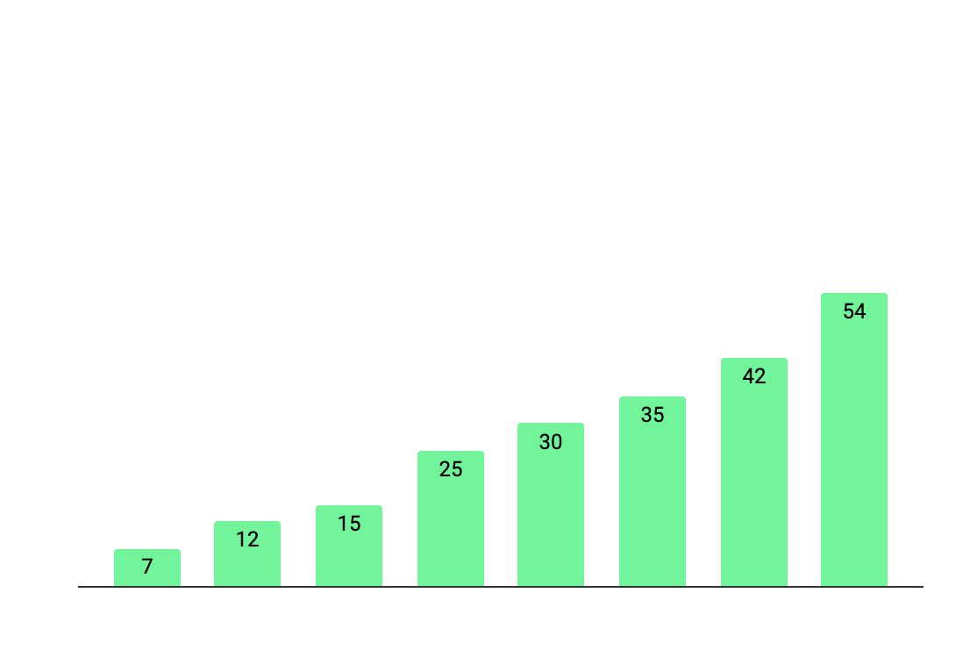
Data First-Sight Properties
190
Original planned time (in hours)
220
Total spent time (in hours)
+15%
Planned hours vs. time spent
Follow the link in the graph to modify its data and then paste the new one here. For more info, click here

Slide 12
1.3. DATA PREPROCESSING
Motivations
Clean
Prepare
Saturn is a gas giant and has several rings
Venus is the second planet from the Sun
Jupiter is the biggest planet of them all
Challenges
Consequences
Despite being red, Mars is a cold place
Saturn is a gas giant and has several rings

Slide 13
02
Major Approach
You can enter a subtitle here if you need it

Slide 14
2.1. Exploratory Data Analysis (EDA)
ID | Tasks | Week 1 | Week 2 | Week 3 | Week 4
1 | Start
2 | Clean the data
3 | Analyze data
4 | Customer approval
5 | Sign off

Slide 15
2.2. METHODOLOGY
Saturn is a gas giant with rings. It's composed mostly of hydrogen and helium
Algorithms | Neptune is far away from us
Impact areas | Saturn is the ringed planet
Context and needs | Jupiter is the biggest planet
Models | Mars is a cold place
Techniques | Earth is the third planet from the Sun

Slide 16
2.3. Model Training
Venus is the second planet from the Sun
Jupiter is the biggest planet of them all
Scope
Constraints
Resources
Risks
Despite being red, Mars is a cold place
Saturn is a gas giant and has several rings

Slide 17
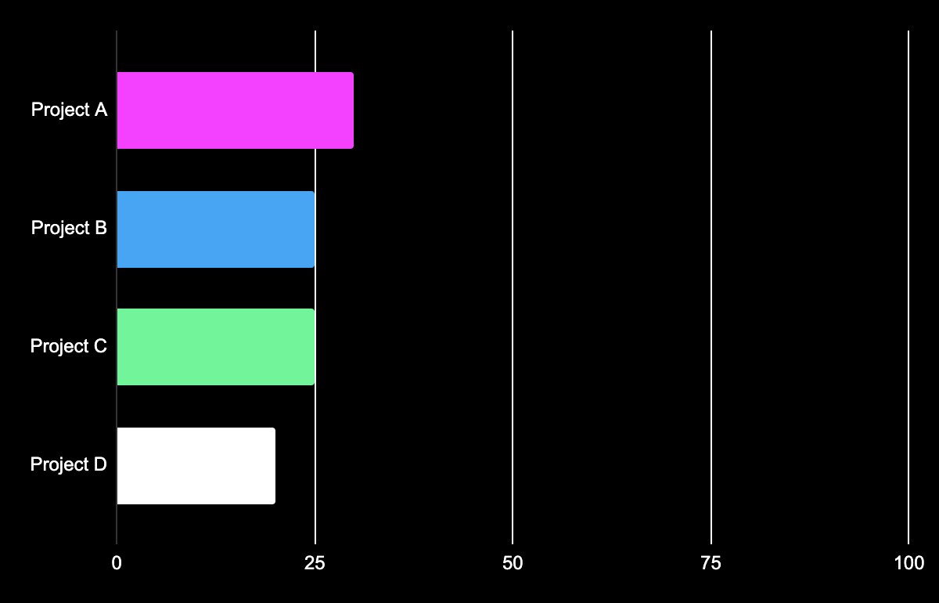
2.3.2Parameter Tunning
30%
25%
Project A
Project B
Venus is the second planet from the Sun
Despite being red, Mars is a very cold place
25%
20%
Project C
Project D
Earth is the place where we all live
Neptune is the farthest planet from the Sun
Follow the link in the graph to modify its data and then paste the new one here. For more info, click here

Slide 18
2.3.3. TUNNING SCHEMA

Slide 19
2.3.4 TRAINING RESULTS
Project A
Project B
Progress
75%
Progress
80%
Planned hours
65%
Planned hours
55%
Resources
55%
Resources
50%
Adjustments
60%
Adjustments
75%

Slide 20
2.4. CHALLENGES FACED
abcskdh | 2. akdhni | 3. ljkdsbn | 4. ldjkbcna
Mercury is the smallest planet | Venus has a beautiful name | Mars is actually a very cold place | The Moon is a natural satellite
Solution | Alternative | Solution | Alternative
Jupiter is the biggest planet | Saturn is a gas giant with rings | Pluto is a dwarf planet. It’s small | Earth is the place where we all live

Slide 21
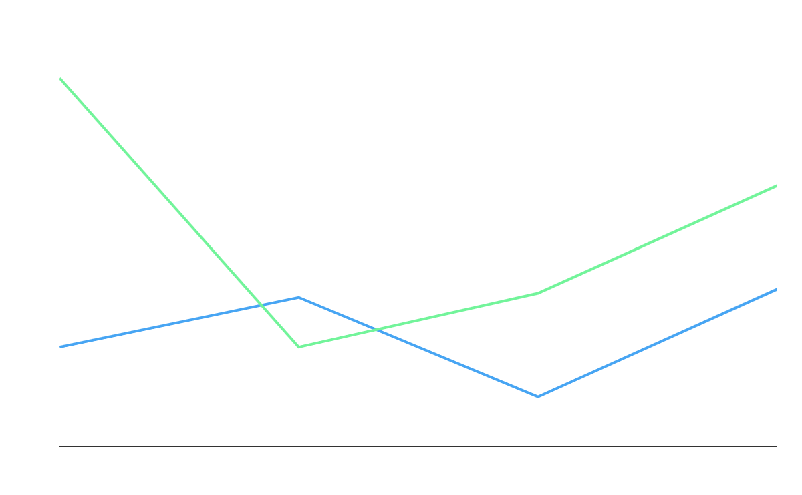
2.5. KEY METRICS for MODEL EVALUATION
Project A
Saturn is composed of hydrogen and helium
Project B
Jupiter is the biggest planet in the Solar System
Follow the link in the graph to modify its data and then paste the new one here. For more info, click here

Slide 22
2.6. Visualization for Support Finding
30%
25%
Project A
Project B
Venus is the second planet from the Sun
Despite being red, Mars is a very cold place
25%
20%
Project C
Project D
Earth is the place where we all live
Neptune is the farthest planet from the Sun
Follow the link in the graph to modify its data and then paste the new one here. For more info, click here

Slide 23
2.7. Lessons LEARNED
Unbeatable Time
Insights
gaines
Mercury is the closest planet to the Sun and the smallest one
Surprising Discoveries
Despite being red, Mars is actually a cold place. It’s full of iron oxide dust
Venus has a beautiful name and is the second planet from the Sun

Slide 24
03
Live
Showcase
You can enter a subtitle here if you need it

Slide 25
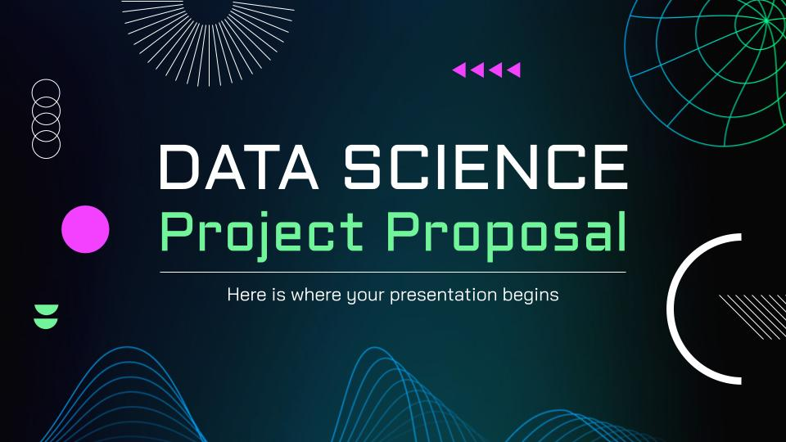
3.2. Recorded Demo
190
Original planned time (in hours)
220
Total spent time (in hours)
+15%
Planned hours vs. time spent
Insert your multimedia content here
Insert your multimedia content here

Slide 26
Live Demonstration
Did you like the resources on this template? Get them for free at our other websites:
Interactive features
Front view group of smiley friends
Smiley people attending a group session
Portrait of young woman with her crossed arms against background
Close up shot smiling aged man
Modern and equipped computer lab
User interfaces developed
Icon Pack: Project Planning | Lineal

Slide 27
$4,250
1,200
892
63
Overall project ROI
Planned hours
Hours spent
Adjustments
Despite being red, Mars is actually a cold place. It’s full of iron oxide dust
Venus has a beautiful name and is the second planet from the Sun
Mercury is the closest planet to the Sun and the smallest one

Slide 28
PROJECT PLANNING WITH RISKS
Phase | Time | Resources | Risks
Business review | 1 week | All analysts | Economic change
Data interpretation | 2 week | All analysts | Data extraction
Data preparation | 2 week | Data scientists | Data extraction
Modeling | 3 week | Analytics manager | Data problems
Evaluation | 2 week | Data visualizer | Economic change
Deployment | 1 week | Data architect | Data problems

Slide 29
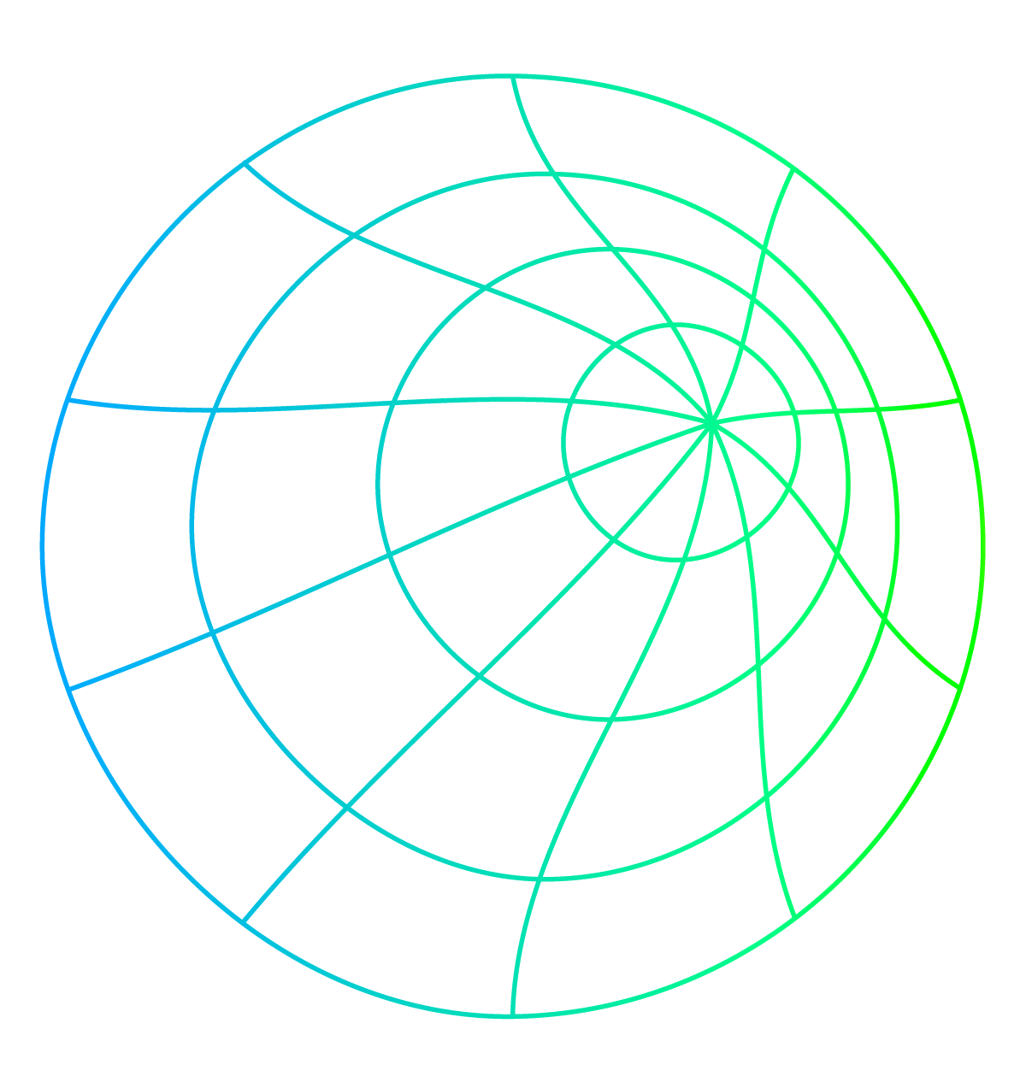
PROJECT MANAGEMENT
ID | Tasks | Week 1 | Week 2 | Week 3 | Week 4
1 | Start
2 | Clean the data
3 | Analyze data
4 | Customer approval
5 | Sign off

Slide 30
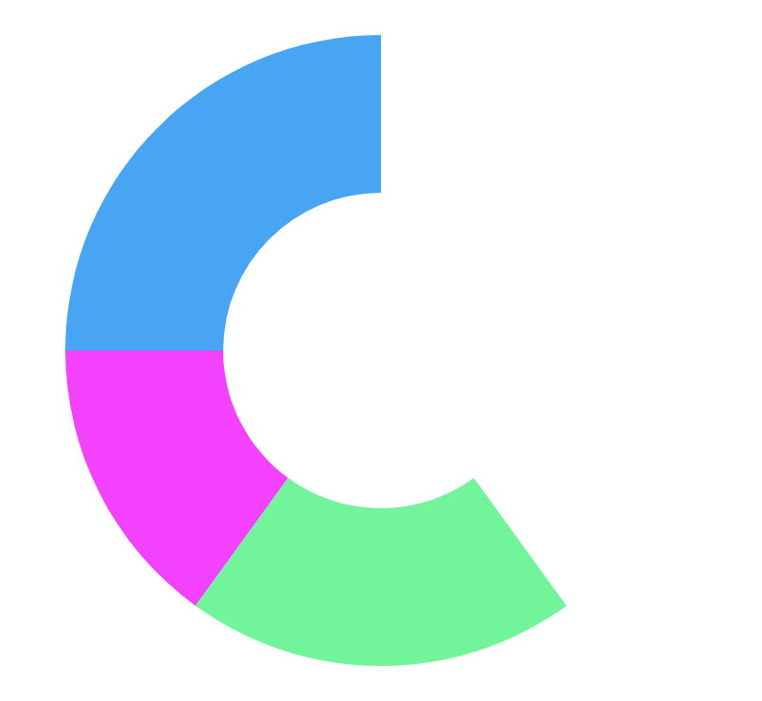
GANTT CHART
Exploitation
40%
Mercury is the closest planet to the Sun
Architecture design
25%
Venus is the second planet from the Sun
Project management
20%
Jupiter is the biggest planet of them all
Dissemination
15%
Neptune is the farthest planet from the Sun
Finish
Last task
Small task
Initial task
Critical
Aug 22
Sep 22
Oct 22
Nov 22
Dec 22
Not critical

Slide 31
SKILL SET ACQUIRED
Mercury
Venus
Mars
It’s the smallest planet in the Solar System
Venus is the second planet from the Sun
Mars is actually a very cold place
Jupiter
Saturn
Neptune
Jupiter is the biggest planet of them all
It’s composed of hydrogen and helium
It’s the farthest planet from the Sun

Slide 32

04
Further
Improvement
You can enter a subtitle here if you need it

Slide 33
PROGRESS TABLE
 | Test A | Test B | Test C
Project 1
Project 2
Project 3

Slide 34
TO BE DONE
Title | Project A | Project B
Author | James Doe | Anna Smith
Amount | $150,000 | $200,000
TRL level | 5 | 4
Period | Oct 25th - Nov 30th | Dec, 10th - Jan 30th
Key word | Malware | Neural networks
Venus has a beautiful name and is the second planet from the Sun

Slide 35
4.1 Additional Analysis & Features to EXPLORE
190
Original planned time (in hours)
220
Total spent time (in hours)
+15%
Planned hours vs. time spent
Follow the link in the graph to modify its data and then paste the new one here. For more info, click here

Slide 36
4.2 Conclusion
Saturn is a gas giant and has several rings. It's composed mostly of hydrogen and helium. It was named after the Roman god of wealth and agriculture
Problem & solution | What problem have you identified
Methodology | Include a timeline of events here
Goals & KPIs | Describe the details about the project goals
Practical Applications

Slide 37
05
Q&A
You can enter a subtitle here if you need it

Slide 38


TEAM CONTACT
Name
Pau Sabater Nácher
You can describe the topic of the section here
Mathematics & Physics Eng. student
github.com/pausabater13
linkedin.com/in/pau-sabater
Name
Name
You can describe the topic of the section here
You can describe the topic of the section here

Slide 39
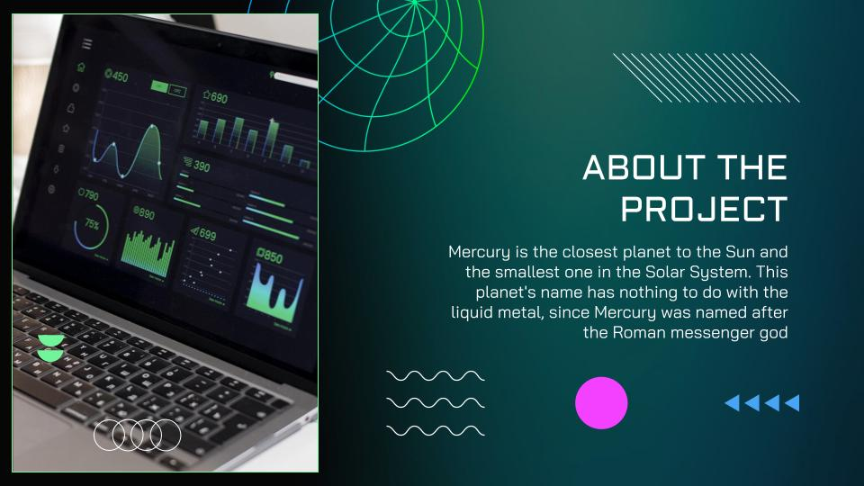
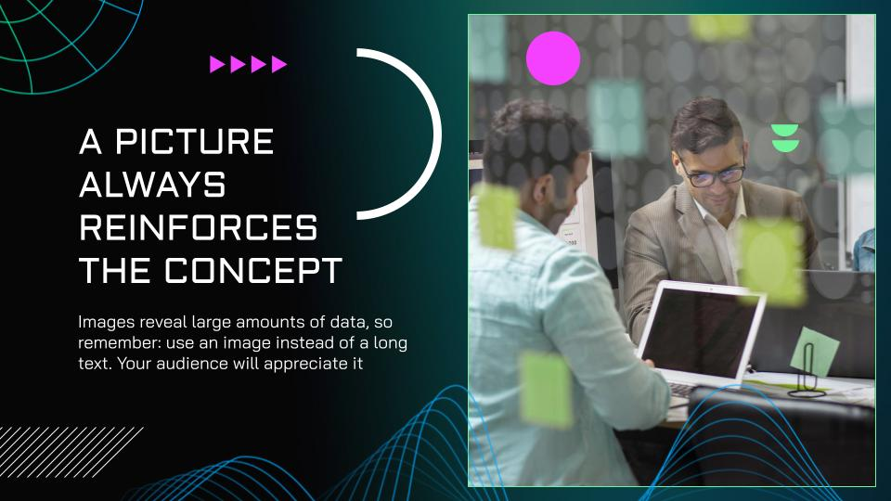
OUR CHANNELS
You can replace the images on the screen with your own work. Just right-click on them and select “Replace image”

Slide 40
PROJECT ROLES & RESPONSIBILITIES
Roles | Domain expertise | Technical skills | Provable skills
Data scientist
Data engineer
Data science developer
Product owner
Significant expertise
Some expertise
Minimal expertise

Slide 41
RESOURCES
Did you like the resources on this template? Get them for free at our other websites:
Libraries & Models
Modern and equipped computer lab I
Modern and equipped computer lab II
Modern and equipped computer lab III
Modern and equipped computer lab IV
Modern and equipped computer lab V
Modern and equipped computer lab VI
Close up programmer sitting at desk I
Close up programmer sitting at desk II
Medium shot man sitting at desk
Medium shot man typing on laptop
Close up on film texture details
References & Ideas
Modern and equipped computer lab I
Modern and equipped computer lab II
Modern and equipped computer lab III
Modern and equipped computer lab IV
Modern and equipped computer lab V
Modern and equipped computer lab VI
Close up programmer sitting at desk I
Close up programmer sitting at desk II
Medium shot man sitting at desk
Medium shot man typing on laptop
Close up on film texture details

Slide 42
REFERENCES
Mercury is the closest planet to the Sun and the smallest one in the Solar System. Its name has nothing to do with the liquid metal, because Mercury was named after the Roman messenger god
Use bullet points if necessary:
Venus has extremely high temperatures
Earth is the third planet from the Sun
Despite being red, Mars is a cold place
Jupiter is the biggest planet in the Solar System

Slide 43

DATATHON FME 2023
END
Here is where the presentation ends

Slide 44
LOCATIONS
Jupiter
It’s the biggest planet in the Solar System
Saturn
Saturn is a gas giant and has several rings
Mars
Despite being red, Mars is a cold place

Slide 45
ICON PACK

Slide 46
ALTERNATIVE INFOGRAPHICS
Despite being red, Mars is cold
Step 1
Step 2
Mars
Neptune is the farthest planet from the Sun
01
02
Despite being red, Mars is a cold place
Neptune
Neptune is far away from us
It has a beautiful name but is hot
Venus
Step 3
Step 4
Saturn is a gas giant with rings
Venus has a beautiful name, but it’s hot
03
04
Pluto is now considered a dwarf planet
Saturn
Sep
Nov
Mars
Despite being red, Mars is a cold place
Despite being red, Mars is a cold place
Venus has a beautiful name, but it’s hot
Neptune is far away from Earth
Neptune
Aug
Oct
Saturn
Saturn is a gas giant and has several rings
Saturn is a gas giant with several rings
Neptune is the farthest planet from the Sun
It has a beautiful name, but it’s hot
Venus

Slide 48
JANUARY
FEBRUARY
MARCH
APRIL
MAY
JUNE
PHASE 1
Task 1
Task 2
PHASE 2
Task 1
Task 2
JANUARY
FEBRUARY
MARCH
APRIL
PHASE 1
Task 1
Task 2

Slide 51
...and our sets of editable icons
You can resize these icons without losing quality.
You can change the stroke and fill color; just select the icon and click on the paint bucket/pen.
In Google Slides, you can also use Flaticon’s extension, allowing you to customize and add even more icons.

Slide 52
Educational Icons
Medical Icons

Slide 53
Business Icons
Teamwork Icons

Slide 54
Help & Support Icons
Avatar Icons

Slide 55
Creative Process Icons
Performing Arts Icons

Slide 56
Nature Icons

Slide 57


